Slide 1

Project 3 Final Presentation
Rachel Snow, Evan Galloway, Sean Marshall, Jack Behringer, Theodore Waldman

Slide 2
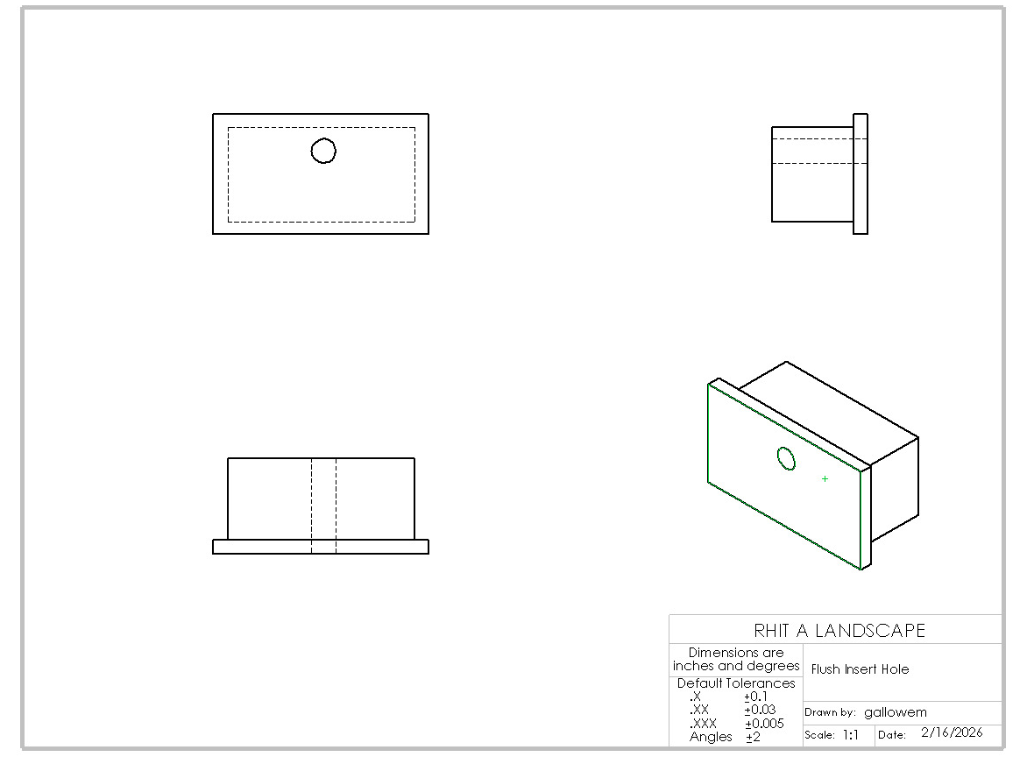
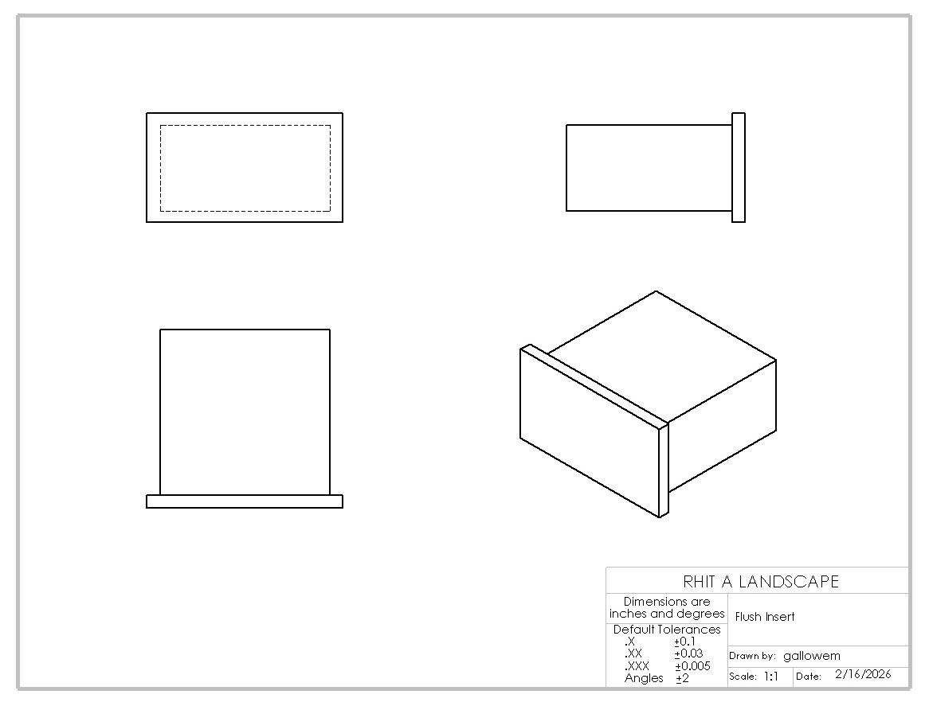
Engineering Drawings
Flush Insert
Insert with Hole

Slide 3
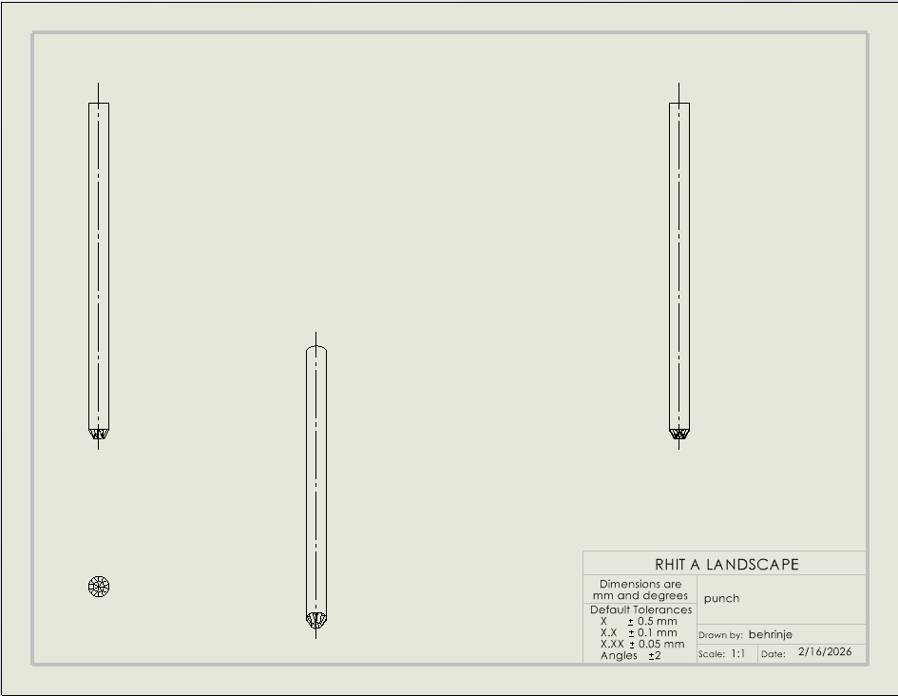
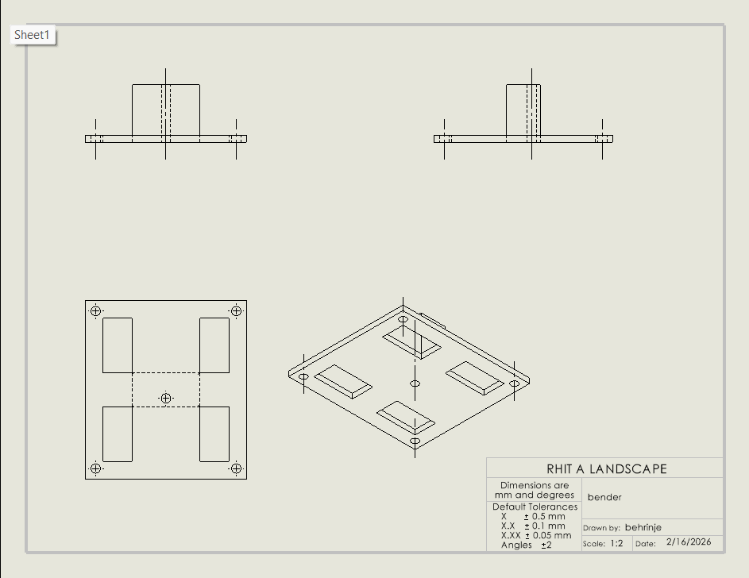
Engineering Drawings Continued..
Bender
Punch

Slide 4
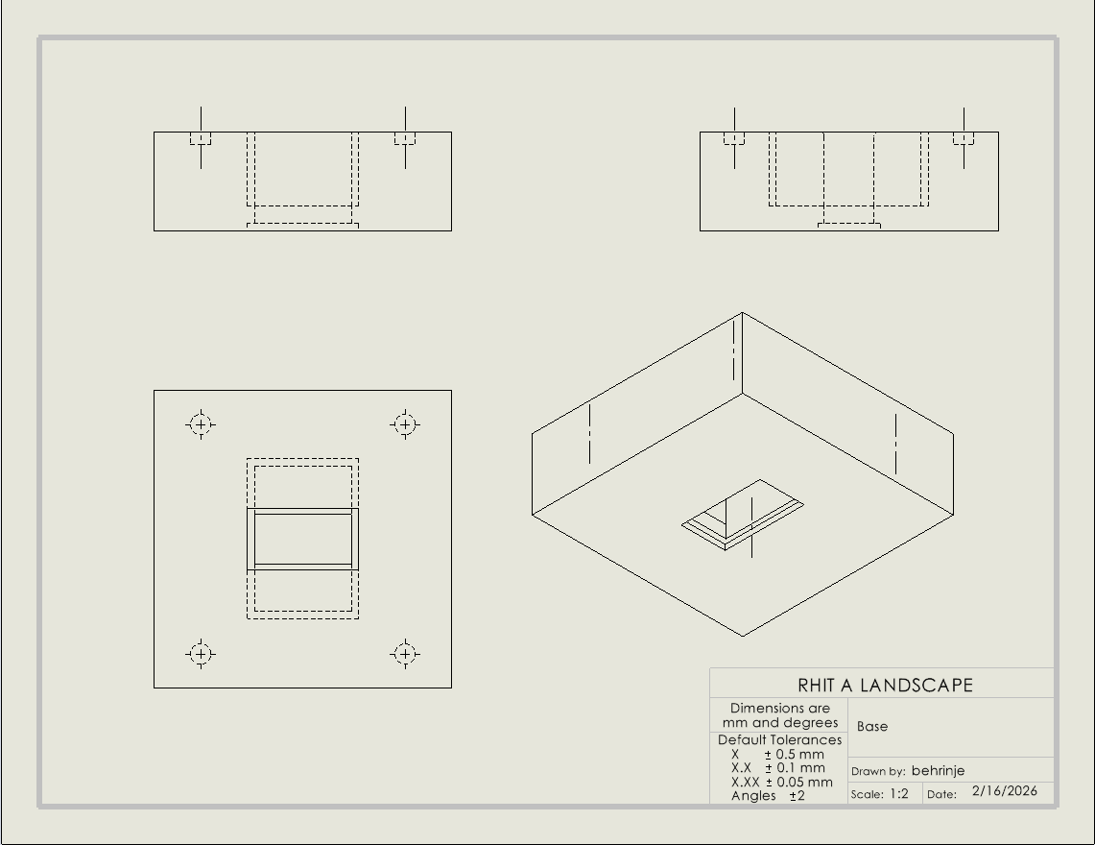
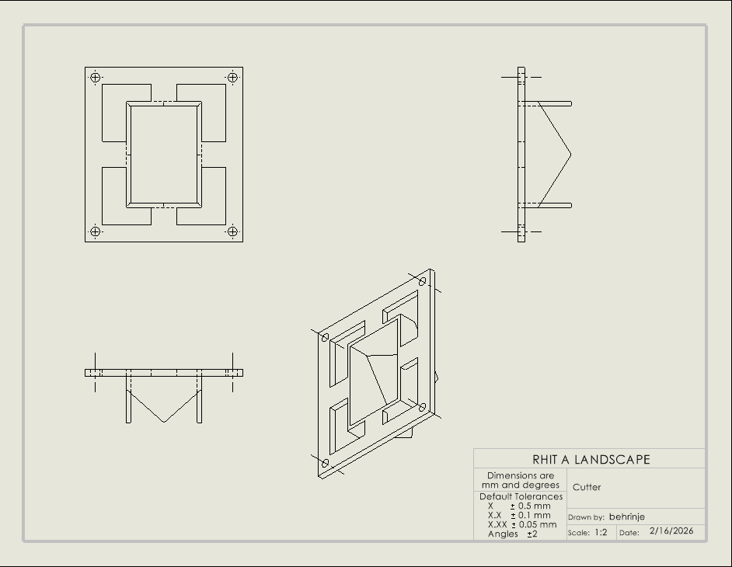
Engineering Drawings Continued...
Cutter
Base

Slide 5
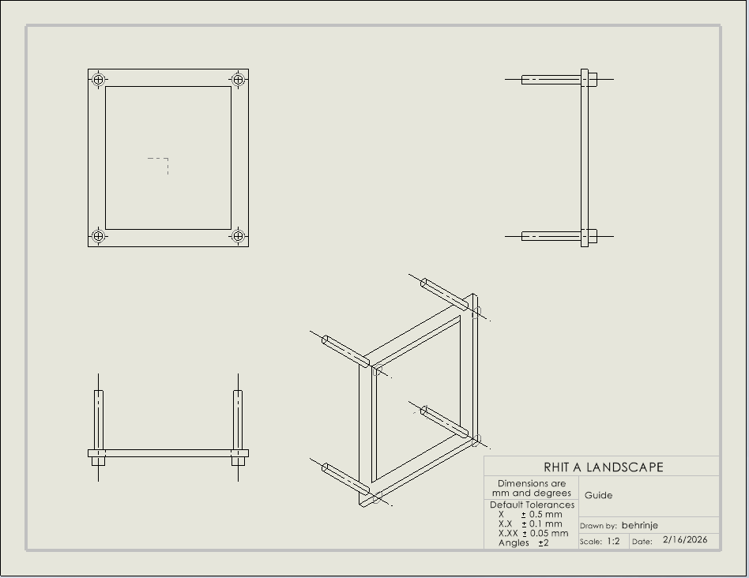
Engineering Drawings Continued...
Guide

Slide 6
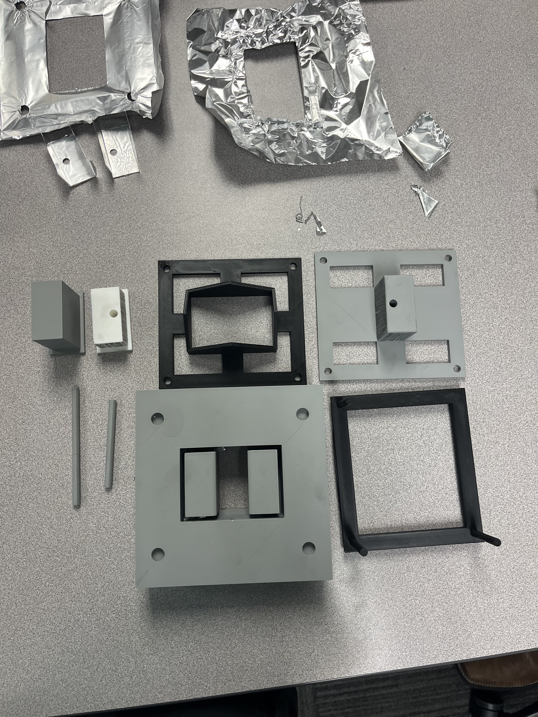
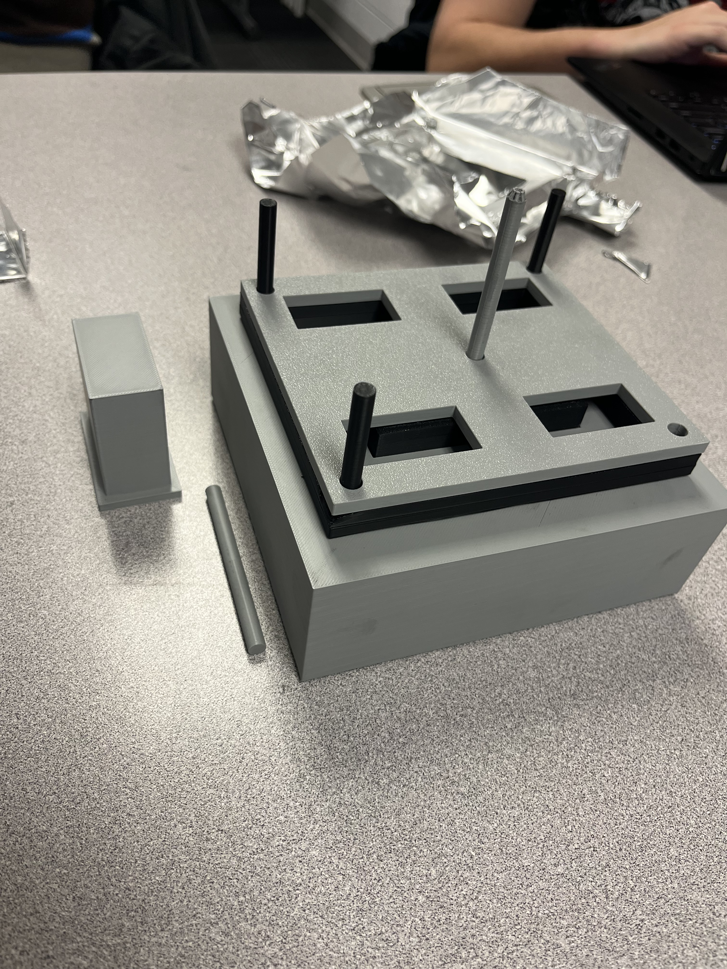
Stamping Press

Slide 7
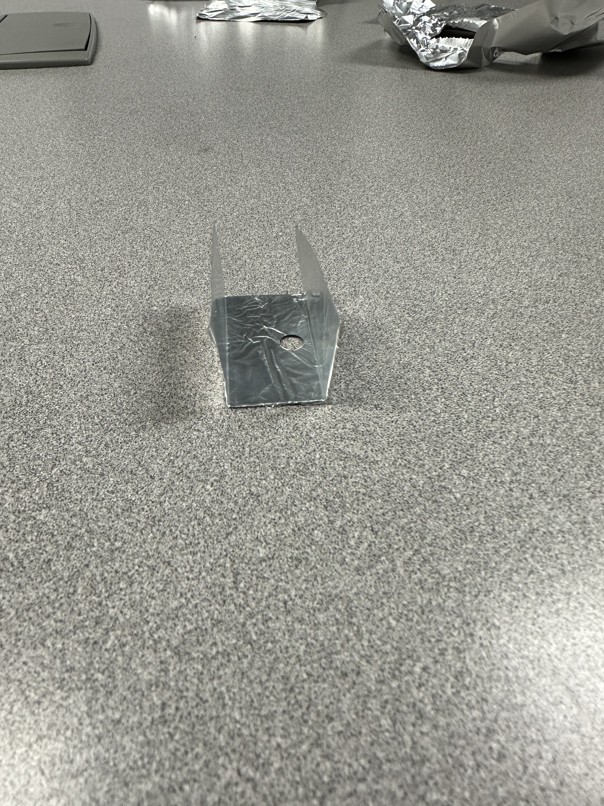
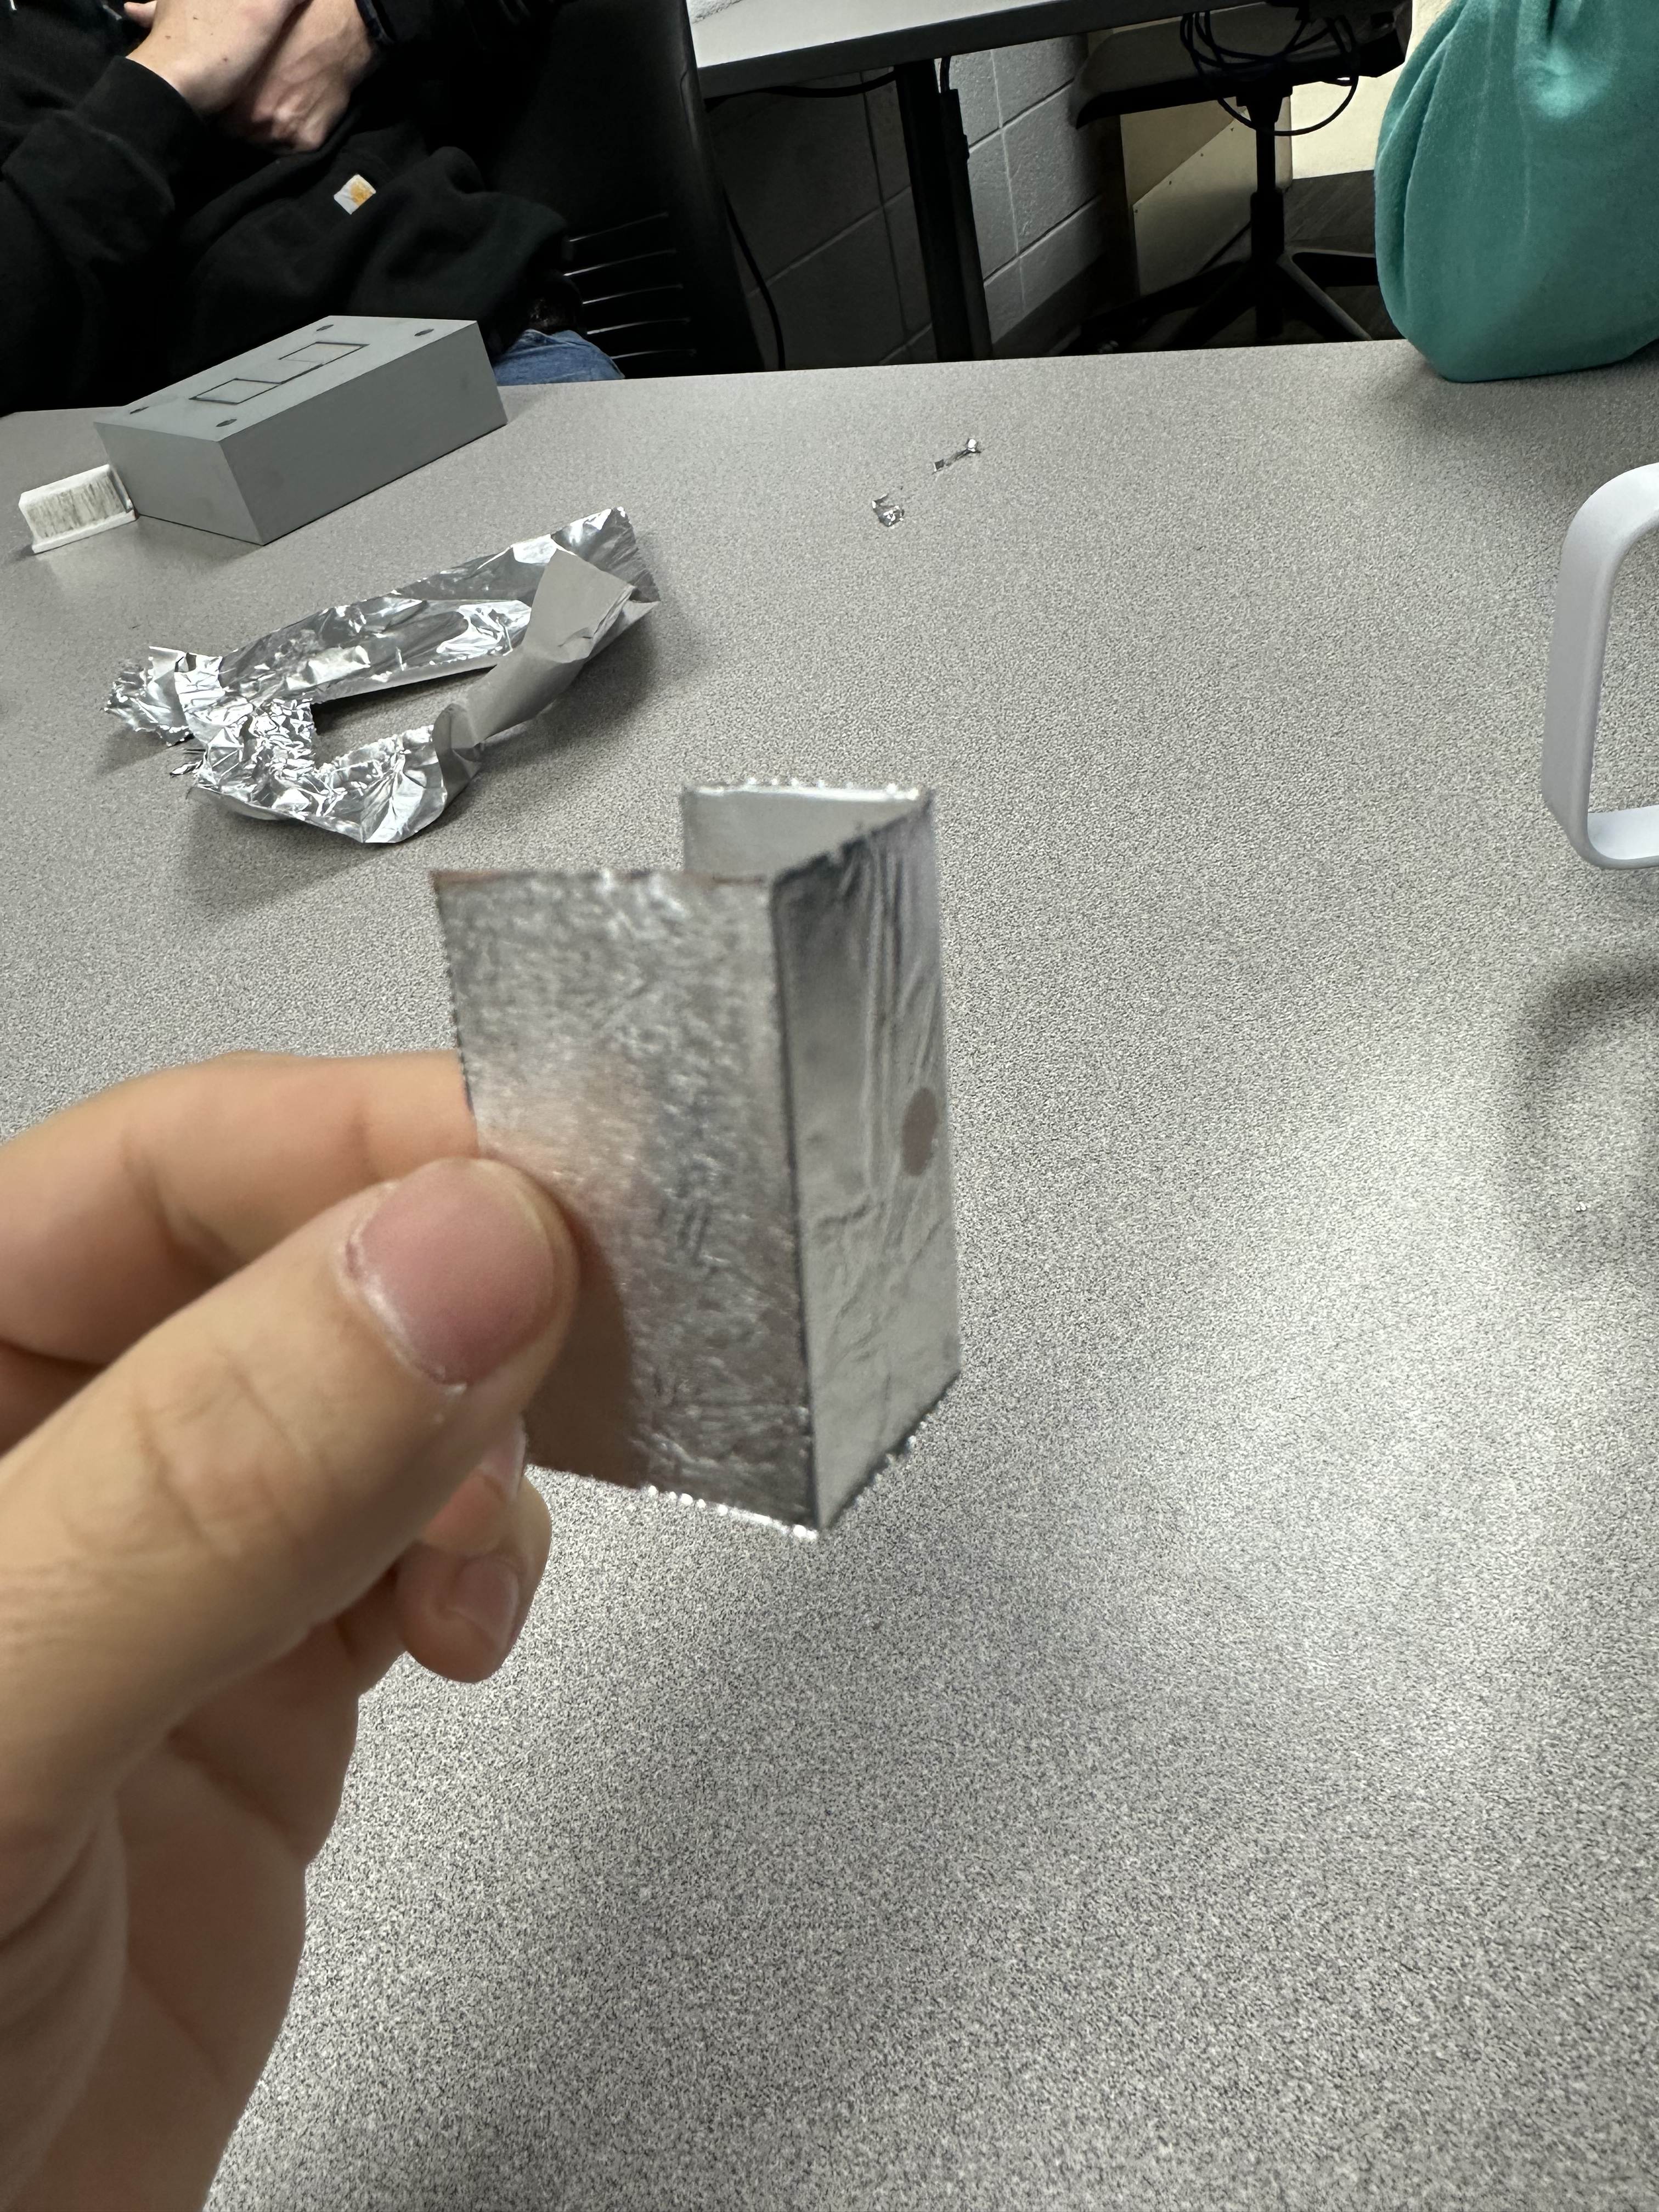
Stamped Part

Slide 8
Lessons Learned
The importance of tension.
Having guides to hold tension
Having a flush middle section to keep tension and not let the middle part tear
Having a clamshell press to not let the foil shift while bending.
Beware of points and sharp angles.
Drafting the top edge of the bending section led to a more successful bend versus when the aluminum would rip as we tried to bend when the edge was sharp and pointed.
Do not over-constrain.
Having three points of guidance worked better than having all four corners as guides.
Reducing friction.
The addition of graphite to the sides of our bending piece and an insert helped make the movement of our piece's smoother.

Slide 9
For Next Time
Make a smaller base so iterations take less time to print.
Check dimensions against other parts before printing each part so that you do not print inserts that cannot even be used.
Be extra careful when handling all pieces as to not break thinner rods and guides which forced a reprint.

